Slide 1
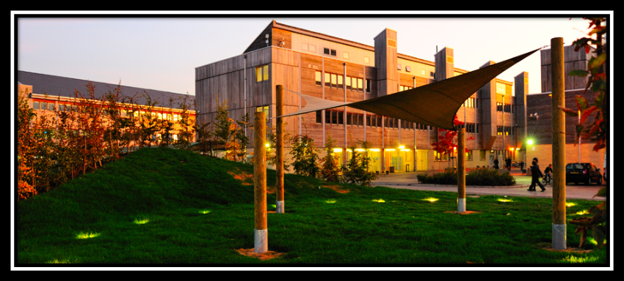
Excellence Innovation Respect
Oakgrove Transition 2021

Slide 2
Excellence Innovation Respect
Transition Day 2021
Welcome to our Virtual Transition Day!
Hopefully today will settle some of your nerves and give you some more information about what life in Oakgrove will be like in September.
Please note that for most of these slides there are voice overs so you may wish to get headphones/speakers or turn the volume up on laptops and tablets so you can hear these.

Slide 3
Excellence Innovation Respect
Headteacher’s Welcome - Mr Tett
Check you’ve seen the welcome Video from Mr Tett (on transition page website: https://www.oakgrove.school/our-school/transition/ ).

Slide 4
Excellence Innovation Respect
Mr Tett
A warm welcome to Oakgrove School and I hope that you and your families are safe and well. This year we are having to launch our transition program differently, the situation with Coronavirus means that our traditional transition cannot take place. We would love to have you visit Oakgrove, get a better understanding of the school and how we operate, however, we are confident that the support that you will get today and over the next few weeks will enable you to be fully prepared for your exciting start at Oakgrove in September.

Slide 5
Excellence Innovation Respect
Please note all timings are flexible except for the live aspect highlighted in yellow.
Timetable
Timings (approx) | Students Joining from Home: Activities
9.40-10.10am (25-30 mins) | Welcome Video and PP Assembly to watch
10 - 10.20 (10 mins) | Virtual Tour Activity (link on website)
10.20-10.40 (20 mins) | Booklet Tasks
10.40-11am (20 mins) | Break
11-11.40 (40 mins) | LIVE Online Virtual Lesson - Geography (zoom link emailed)
11.40 - 12 (20 mins) | Independent Learning Task (explained in live lesson)
12-12.15 (15 mins) | Video link for Student Voice Representatives answering questions from primary School Student Visits & PP of Q&A
12.15-12.30 (15 mins) | Summary Assembly PP and Reflections Task
12.30 (could be extended) | Finish or Option to continue work on the booklet tasks or finish these at a later point

Slide 6
Excellence Innovation Respect
Please note all timings are flexible except for the live aspects highlighted in yellow.
Timetable
Timings (approx) | Students Joining from School: Activities
9:40 – 10:10 | Welcome Video and PP Assembly to watch
10:10 – 10.20 | Virtual Tour (link on website)
10:20 – 10:40 | Booklet Tasks
10.40 - 11.00 | Break
11.00 - 11.30 | Live Online Lesson 1
11:30 – 12:00 | Live Online Lesson 2
12:00 – 12:05 12.05- 12.10 | Student Voice Representatives Pre-recorded video link for question and PP Q&A Live Q&A session with Student Voice Representatives
12.15 12.30 | Summary Assembly PP & Reflections of the day (on website from Monday)
12.30 | Finish (option to continue with booklet tasks or complete at later point)

Slide 7
Excellence Innovation Respect
Oakgrove School’s Values and Ethos
Oakgrove School was established in 2005 and the school built its ethos around its core values of ‘Excellence, Innovation and Respect’. This has been at the heart of everything the school has achieved ever since.
The school has grown significantly since it opened, partly through the Milton Keynes’ Expanding the Best’ program, but also through the construction of our fantastic Primary & Nursery site to become an ‘all-through’ school. Oakgrove is now a 3 – 19 education provider, supporting over 2100 pupils.
Oakgrove’s track record of producing many of the highest grades in Milton Keynes and wider area is maintained year after year. It is this very track record of high achievement and success that all those associated with the school are proud of. Our students have moved on into the top universities in the country and have gained fantastic apprenticeships and careers following their time at Oakgrove.
Excellence in all that we do – its not a skill but an attitude!
Innovation – turning an idea or issue into a solution!
Respect – to show respect for others, the environment and yourself by being considerate of people’s feelings, rights, traditions and differences.

Slide 8
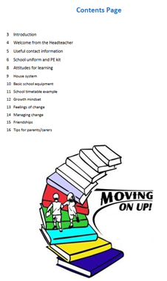
Transition Information Booklet
Please make sure you look at the Oakgrove School Information Booklet – this is full of lots of useful tips and key information on school policies which will help your have a smooth start in September.
Copies have been emailed to schools/parents/carers and they are also available to down load from the school website: https://www.oakgrove.school/our-school/transition/
If you have a hard copy of this take a moment to look through it now and write your name on it ….

Slide 9
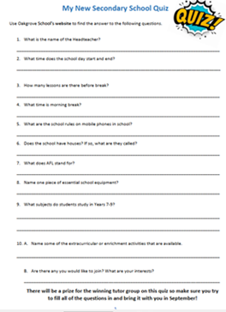
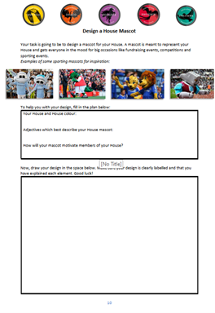
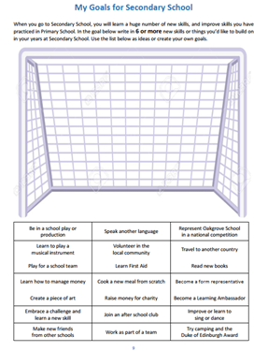
Transition Activity Booklet
Please make sure you also complete look at and complete the Oakgrove School Activity Booklet – you might not be able to complete all of the tasks today but by September you should aim to fill in as much as you can and bring it along on your first day when you meet your tutor.
Copies have been emailed to schools/parents/carers and they are also available to down load from the school website: https://www.oakgrove.school/our-school/transition/
If you have a hard copy of this take a moment to look through it now and write your name on it ….

Slide 10
Transition
Think about or discuss - How might this photo represent the change you are about to make in September?
How do you currently feel about the change?....what are you excited about? Are you nervous about anything? Have you spoken to family/friends about these feelings?

Slide 11
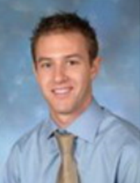
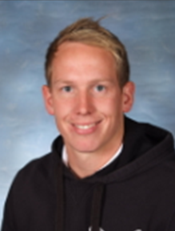
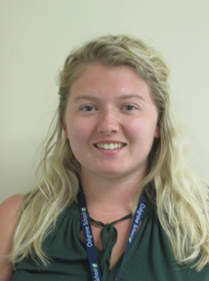
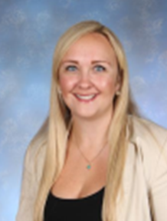
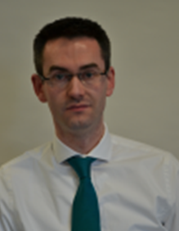
Who’s who in leadership?
Mr Boon
Deputy Headteacher
Whole School Behaviour
Miss Yeoman
Assistant Head of Year 7
Mr Robinson
Head of Year 7
Mrs Coleridge Smith
Assistant Headteacher KS3 Behaviour
Mr Pettit
Deputy Assistant Headteacher KS3 Behaviour

Slide 12
Year 7 September 2021: Tutors
7O | Mr Singh
7A | Miss Gibbons
7K | Mr Mellor
7G | Mr Khan
7R | Mrs Gandhi
7V | Miss Harrison
7E | Mrs Swift
7S | Mr Booth
7C | Mrs Misso
7S | Mrs Chudasama
Mr Robinson – Head of Year
Miss Yeoman – Assistant Head of Year
Check the Transition page for a welcome message from each of your tutors (on a separate PP)

Slide 13
Excellence Innovation Respect
The Role of your Tutor
Your tutor will be your main point of contact throughout your time at Oakgrove. They will see you every morning during registration meaning they are a consistent part of your daily routine and someone you can speak to about problems, share successes with and get advise on a variety of areas both in school and at home.
This means hopefully five years of working together as a team.

Slide 14
Excellence Innovation Respect
Registration
Review report targets
Notices about the day
10 minutes
Every morning
8.30-8.40am
Monitor Uniform
Sign Planners
Discuss issues with students
Monitor Attendance
Rewards

Slide 15
Oakgrove Secondary School Contact Tree

Slide 16
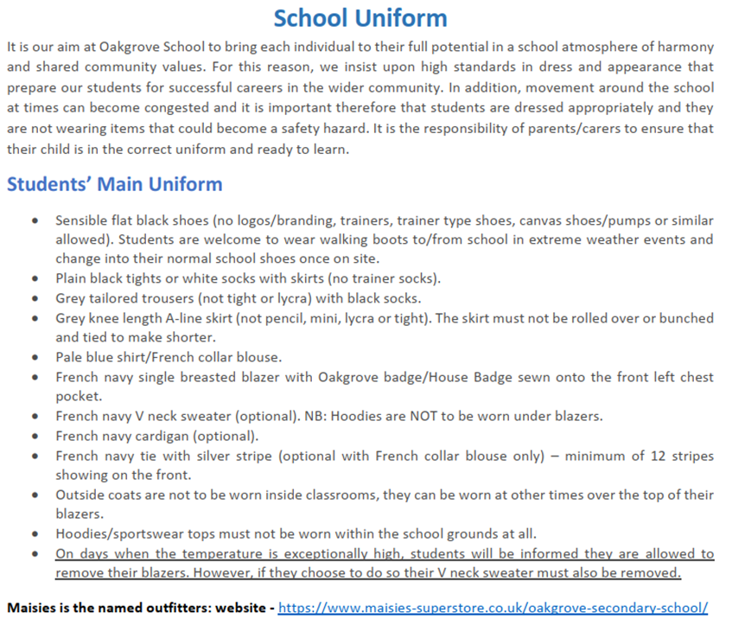
Oakgrove Secondary School Uniform
Take some time later to look at the Uniform pages in your information booklets (also on the school website). Then later make sure you speak with your parent/carers about ordering your school uniform. Try not to leave it too late ordering as this might lead to delays in September and check you are ordering the correct uniform so it doesn’t lead to any issues in September.

Slide 17
First
Impressions

Slide 18
Excellence Innovation Respect
Live Online Lessons
At 11am there will be live on-line lessons starting. Unfortunately, these timings are not flexible so please make sure you are ready with pen/pencil and some paper if you wish to take part in these lessons.
Behaviour Expectations – please remember that whether you are joining from home or school that we expect to see polite and respectful behaviour at all times. The lessons are shorter as they are in a virtual format (most of your lessons will be 1 hour at Oakgrove) but they are designed to give you a taster for learning at Oakgrove Secondary School. Please make sure you are on mute (unless specifically asked to unmute by the teacher) so you don’t disturb the teacher and learning of others, be mindful of what or who is in your background (e.g. no personal information like address or photos, try not to have people walking behind as it can be distracting for others, consider any other safeguarding issues or potential distraction's).
Remember – these lessons are an optional extra not compulsory so please don’t worry if you do miss them or you have computer issues.

Slide 19
Excellence Innovation Respect
What's next?
Timings (approx) | Students Joining from Home/School Activities
9.40-10.10am (25-30 mins) | Welcome Video and PP Assembly to watch
10 - 10.20 (10 mins) | Virtual Tour Activity (link on website)
10.20-10.40 (20 mins) | Booklet Tasks
10.40-11am (20 mins) | Break
Remember that all of these timings are flexible and the only parts that can’t be changed are the live elements like the lessons which start at 11am!
Check emails for the appropriate zoom links to join.

Slide 20
Excellence Innovation Respect
Virtual Tour
Click on this link (also on the website under transition):
https://virtualtour.oakgrove.school/transition/
Use this tour to look around the school – try to take note of key parts such as reception and where you walk in via the gates, the different subject areas, canteens and outdoor spaces. If you’re in a group you might want to find one interesting facts about the following:
- where you enter/leave the school? (grey gates)
- somewhere you could eat?
- somewhere you could get fresh air at break/lunch?
- Where you could go to read a book?
- for your favourite subjects, find something interesting in their classroom.
You only have 10 minutes for this but you could come back to it later in the day or at another time.
Once you’ve finished you can start looking at the information and activity booklets.

