Slide 1
Thursday, 07 July 2022
Life
Studies

Slide 2
Thursday, 07 July 2022
Life
Studies
Relationships
Puberty and emotional changes

Slide 3
Relationships
Ground rules
Thursday, 07 July 2022
Ground rules for our room
Many topics we cover in Life Studies can be very sensitive and can have a different level of importance and effect on different people. To get the best out of each lesson your participation is essential. In order to respect each other’s opinions and right to freely contribute we should establish some ground rules.
Task
Take a few minutes with a partner to go over your rules from the last topic and come up with any amendments you think are important to helping you feel confident to contribute in your Life Studies lessons?
Now feed back to the class.
Amend your rules if necessary
EXCELLENCE - INNOVATION - RESPECT

Slide 4
Relationships
Thursday, 07 July 2022
Key learning objectives
We are learning: about how the emotions are affected by puberty, how this may affect relationships and how to manage this
EXCELLENCE - INNOVATION - RESPECT

Slide 5
Relationships
Thursday, 07 July 2022
Key learning outcomes
I can describe the main physical and emotional changes experienced during puberty I can evaluate how relationships can be affected during puberty I have strategies for managing the emotional aspects of puberty
EXCELLENCE - INNOVATION - RESPECT

Slide 6
Relationships
Thursday, 07 July 2022
Baseline activity
What is ‘puberty’?
How well do you understand what puberty is?
1O
I know it all
1
Not at all
EXCELLENCE - INNOVATION - RESPECT

Slide 7
Relationships
Thursday, 07 July 2022
Baseline activity
EXCELLENCE - INNOVATION - RESPECT

Slide 8
Anonymous question box
On a piece of paper, write at least one question you have relating to these topics:
consent
menstrual wellbeing
managing relationship conflict
healthy relationships
puberty and how relationships might change during puberty

Slide 9
Scenarios
Can you respond to the scenarios?

Slide 10
Scenarios
Can you respond to the scenarios?
1. I’m really worried that everyone is starting to talk about periods and voice changes and I’m not experiencing any of this. Am I normal?
2. I’ve suddenly started arguing with my family all the time and it’s getting me down. Why can’t we get on like we used to?
3. One of my older brother’s friends keeps suggesting we spend some time alone together at his place. I really fancy him but something doesn’t feel right. What should I do?
4. My auntie keeps forwarding messages and posts about how women should behave before marriage and within relationships. It’s making me uncomfortable, and I’m worried I’m supposed to behave in ways that don’t feel right. What should I do?

Slide 11
What is ‘puberty’?
How might relationships change during or after puberty?
Puberty is the stage in someone's life when they develop from a child into an adult because of changes in their body that make them able to have children. These physical changes are accompanied by changes that can affect emotions as hormones change and people’s identities develop.

Slide 12
Changes during puberty
Sort the cards to show the different types of physical changes young people experience during puberty:
Biologically male
Can affect anyone
Biologically female

Slide 13
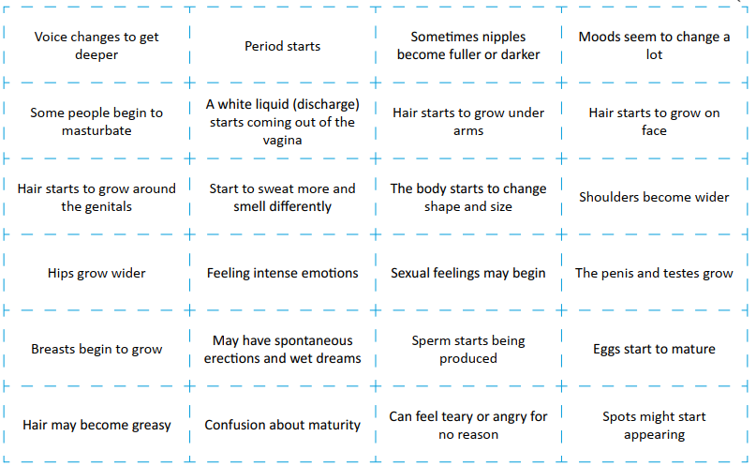
Changes during puberty
Sort the cards to show the different types of physical changes young people experience during puberty:

Slide 14
Changes during puberty
Now, identify and group together the changes described on the cards which are likely to affect the relationships young people have with others (this might include friends, family, or romantic relationships). These would include: • Moods seem to change a lot • Sexual feelings may begin • Confusion about maturity • Feeling intense emotions • Can feel teary or angry for no reason

Slide 15
Changes during puberty
Which of these changes are likely to affect the relationship young people have with others?
(This might include friends, family, or romantic relationships).
Mood seems to change a lot
Sexual feelings may begin
Confusion about maturity
Feeling intense emotions
Can feel teary or angry for no reason

Slide 16
Managing relationships during puberty
In your groups, pick a scenario and give advice to the character about what they should do next.
Notes:
Puberty and family life 15 mins Explain to students that managing relationships during puberty can take some work. Divide the class into groups and ask them to pick a scenario from Resource 3: Family scenarios. Ask them to give advice to the character about what they should do next to resolve the concern. Be sensitive to any students whose home situation may make this activity more challenging. Invite class feedback. If students do not identify these strategies themselves, draw out key suggestions, such as: • It’s good to talk and be open and honest with family, even if this can feel embarrassing or awkward • Writing a bullet point list to take into a conversation or writing a letter can help if someone is worried about what to say © Medway council 2021 | 5 Baseline assessment• As young people develop more independence, people may need to negotiate new rules with their parents/carers, and stick to them! • Demonstrating responsible behaviour and helping out where possible builds trust with parents/ carers • Find a good time and place to talk to family about embarrassing or difficult issues; for example, they might find it harder to listen if they are in the middle of cooking dinner or rushing out to the shops • Remember there are lots of sources of advice and support on puberty including teachers at school and websites like Childline • It is important to demonstrate the ability to balance time between friends/relationships and school work, for example by making sure to complete homework before asking to go out with friends • Some parents/carers are more open to these kinds of discussions than others. Speaking to another trusted adult can help.

Slide 17
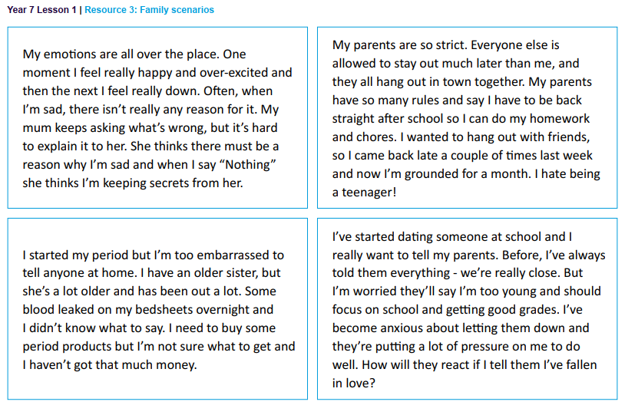
Managing relationships during puberty

Slide 18
Managing emotions suggestions
Can you suggest any ways young people can manage the difficult emotions, mood swings and unpredictable reactions that sometimes occur during puberty?
Notes:
Managing emotions suggestions 10 minsAsk students to suggest ways young people can manage the difficult emotions, mood swings and unpredictable reactions that sometimes occur during puberty. Ideas could include: • Strategies to support mental health such as exercise, relaxation techniques • Prioritising healthy sleep patterns • Being honest about overreactions and taking responsibility for poor behaviour • Using techniques to find breathing space in conversations e.g. “I just need to get a drink – then can we sit down and talk about this?” • Checking in with family/friends when feeling calm to get ahead of any worries e.g. “I’m worried I’ve not been focusing as much in class as I’ve been struggling to sleep recently – can we talk about it before parents’ evening?” Support: Students could be given a set of question prompts – who should the person tell and what might they say? Challenge: Students could provide a written response in the form of an advice column

Slide 19
More activities
Puberty products
Look at some different products relating to puberty and discuss:
How might they be used?
Why might they be necessary?
Offering support
Return to the scenarios from the start of the lesson. Can you offer each character an appropriate source of support – who would be best for them to talk to and why?

Slide 20
Question box and signposting support
If you would like further guidance or support:
speak to a parent/carer, tutor, head of year, school nurse/counsellor or other trusted member of staff in the school
Visit:
A Better Medway: www.abettermedway.co.uk
Childline: www.childline.org.uk 0800 1111

Slide 21
Signposting
Signposting
Thursday, 07 July 2022
If you want to talk to someone about today’s lesson or find out more information about this topic the following available:
Your Tutor
Your Head of Year
Any of these links/numbers
https://www.samaritans.org/about-samaritans/
https://www.kooth.com/
Under 18yrs
EXCELLENCE - INNOVATION - RESPECT

Slide 22
Signposting
Signposting Useful contacts – for young people
Thursday, 07 July 2022
Beat
0808 801 0711 (youthline) 0808 801 0811 (studentline) beateatingdisorders.co.uk Under 18s helpline, webchat and online support groups for people with eating disorders, such as anorexia and bulimia.
Campaign Against Living Miserably (CALM)
0800 58 58 58 thecalmzone.net Provides listening services, information and support for anyone who needs to talk, including a web chat.
Centrepoint
0808 800 0661
Details of places you can go if you're a young person looking for support or information. Useful contacts
Action for Children
actionforchildren.org.uk Charity supporting children, young people and their families across England.
Anxiety UK
03444 775 774 (helpline) 07537 416 905 (text) anxietyuk.org.uk Advice and support for people living with anxiety.
EXCELLENCE - INNOVATION - RESPECT

Slide 23
Relationships
Thursday, 07 July 2022
title
EXCELLENCE - INNOVATION - RESPECT

Slide 25
Relationships
Thursday, 07 July 2022
Baseline activity revisited
Go back to the first task and re-read your answer. Using a different colour would you add or change anything?
EXCELLENCE - INNOVATION - RESPECT

