Slide 1
Wednesday, 18 May 2022
Life
Studies

Slide 2
Wednesday, 18 May 2022
Life
Studies
Relationships
Recognising & Challenging Stigma

Slide 4
Relationships
Ground rules
Wednesday, 18 May 2022
Ground rules for our room
Many topics we cover in Life Studies can be very sensitive and can have a different level of importance and effect on different people. To get the best out of each lesson your participation is essential. In order to respect each other’s opinions and right to freely contribute we should establish some ground rules.
Task
Take a few minutes with a partner to go over your rules from the last topic and come up with any amendments you think are important to helping you feel confident to contribute in your Life Studies lessons?
Now feed back to the class.
Amend your rules if necessary
EXCELLENCE - INNOVATION - RESPECT

Slide 5
Relationships
Wednesday, 18 May 2022
Key learning outcomes
Agreeing on a definition of stigma
Finding our how to recognise stigma
Understanding some of the effects of stigma
Learning three simple strategies to challenge stigma
EXCELLENCE - INNOVATION - RESPECT

Slide 6
Relationships
Wednesday, 18 May 2022
Key learning objectives
The aim of this lesson is to think about stigma and how we can all play a role in challenging stigma positively.
We will:
Define what we mean by stigma and how to recognise it
Look at some of the affects of stigma
Look at some strategies for challenging stigma
EXCELLENCE - INNOVATION - RESPECT

Slide 7
Relationships
Wednesday, 18 May 2022
Baseline activity
What does stigma mean?
EXCELLENCE - INNOVATION - RESPECT

Slide 8
Newspaper headlines
Can you work out what “stigma” means, from the context of the newspaper headlines?
Task
In groups read the headlines, can you a definition of stigma?
Now feedback to the groups

Slide 9
News headlines

Slide 10
So what do we mean by ‘stigma’?
Stigma – noun
A strong feeling of disapproval that most people in a society have about something, especially when this is unfair:
- There is no longer any stigma to being divorced
- Being an unmarried mother no longer carries the social stigma that it used to
Cambridge Dictionary
a mark of shame or discredit
Merriam-Webster
If something has a stigma attached to it, people think it is something to be ashamed of.
Collins

Slide 11
How would I react to stigma?
In 3 groups read the scenario you have been given and consider:
How would you feel in this situation?
Would you know that you had been stigmatised?
What would you do? Are there any activities or situations you might avoid?
What might be the effect of this behaviour on yourself and others?
Who would you tell (if anyone)?
Now feedback to the class

Slide 12
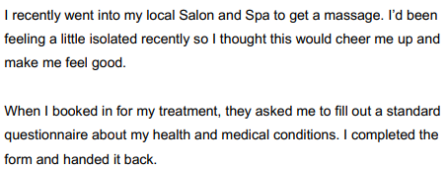
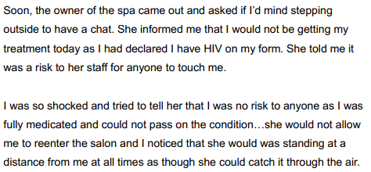
Scenario 1 – Shirley, 42 - Manchester

Slide 13
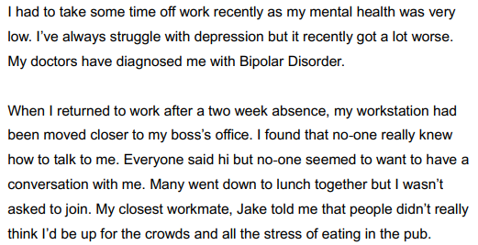
Scenario 2 – Sadiq, 24 - London

Slide 14
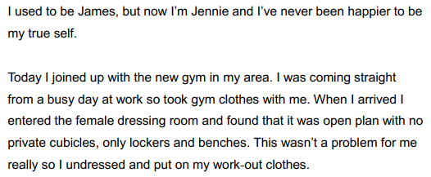
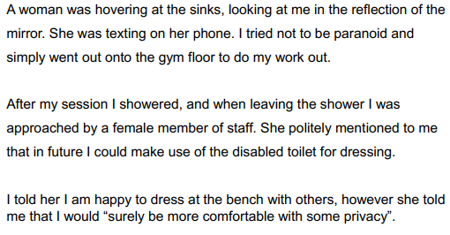
Scenario 3 – Jennie, 31 - Bristol

Slide 15
How can we challenge stigma?
Revisit the scenarios in the previous exercise.
What do we need to challenge stigma?
What tools or resources?
What knowledge or skill will help us?
What can we do as individuals? As a community?
Brainstorm some thoughts and ideas, use the Stigma Toolkit worksheet or use your book to make your notes.

Slide 16
A toolkit for challenging stigma

Slide 17
Relationships
Wednesday, 18 May 2022
Baseline activity revisited
Revisit your own definition of the word stigma. With a different colour pen would you change or add anything?
EXCELLENCE - INNOVATION - RESPECT

Slide 18
Signposting
Signposting
Wednesday, 18 May 2022
If you want to talk to someone about today’s lesson or find out more information about this topic the following available:
Your Tutor
Your Head of Year
Any of these links/numbers
https://www.samaritans.org/about-samaritans/
https://www.kooth.com/
Under 18yrs
EXCELLENCE - INNOVATION - RESPECT

Slide 19
Signposting
Signposting Useful contacts – for young people
Wednesday, 18 May 2022
Beat
0808 801 0711 (youthline) 0808 801 0811 (studentline) beateatingdisorders.co.uk Under 18s helpline, webchat and online support groups for people with eating disorders, such as anorexia and bulimia.
Campaign Against Living Miserably (CALM)
0800 58 58 58 thecalmzone.net Provides listening services, information and support for anyone who needs to talk, including a web chat.
Centrepoint
0808 800 0661
Details of places you can go if you're a young person looking for support or information. Useful contacts
Action for Children
actionforchildren.org.uk Charity supporting children, young people and their families across England.
Anxiety UK
03444 775 774 (helpline) 07537 416 905 (text) anxietyuk.org.uk Advice and support for people living with anxiety.
EXCELLENCE - INNOVATION - RESPECT

Slide 20
Some sources of support and further info:
Mind can provide support around stigma associated with mental health
Very Well Mind also has further info on stigma around mental illness
If you are living with stigma around sexuality or gender, organisations like The Kite Trust, Dhiverse, Stonewall and many others can provide support.
Citizens Advice provides lots of info on discrimination and how to get support if you feel you have been victimized or discriminated against.

