Slide 1
Wednesday, 11 May 2022
Life
Studies

Slide 2
Wednesday, 11 May 2022
Life
Studies
Relationships
Romance

Slide 3
Relationships
Ground rules
Wednesday, 11 May 2022
Ground rules for our room
Many topics we cover in Life Studies can be very sensitive and can have a different level of importance and effect on different people. To get the best out of each lesson your participation is essential. In order to respect each other’s opinions and right to freely contribute we should establish some ground rules.
Task
Take a few minutes with a partner to go over your rules from the last topic and come up with any amendments you think are important to helping you feel confident to contribute in your Life Studies lessons?
Now feed back to the class.
Amend your rules if necessary
EXCELLENCE - INNOVATION - RESPECT

Slide 4
Romance under the Microscope

Slide 5
Relationships
Wednesday, 11 May 2022
Key learning outcomes
The aim of this lesson is to reflect on the idea of romance and what it means to us.
We will:
Define romance and romanticising
Discuss the idea of romance through the lens of gender and sexuality
Think about romantic actions and gestures, and how these influence our feelings
EXCELLENCE - INNOVATION - RESPECT

Slide 6
Relationships
Wednesday, 11 May 2022
Baseline activity
What is romance to you?
Write a sentence/definition or a spider diagram to explain what romance means to you.
EXCELLENCE - INNOVATION - RESPECT

Slide 7
What is romance?
Notes:
What is Romance?
In groups, students should discuss what they think ‘romance’ means and identify one example of romance.

Slide 8
collinsdictionary.com
Romance (noun)
Romance refers to the actions and feelings of people who are in love, especially behaviour which is very caring or affectionate
He still finds time for romance by cooking candlelit dinners for his girlfriend.
He takes a rather sceptical view of love and romance.
Synonyms: love, passion, affection, attachment
Romanticize (verb)
If you romanticize someone or something, you think or talk about them in a way which is not at all realistic and which makes them seem better than they really are.
To treat or regard romantically; give a romantic character to or interpretation of.
He romanticized the past as he became dissatisfied with his present
The film takes a highly romanticized view of life on the streets
He has romanticized the idea of army life
Notes:
Flip the PowerPoint slide to the dictionary definition of romance and compare.
Flip the PowerPoint again to reveal the definition of ‘romanticising’. Get students to identify three things they think are unjustifiably romanticised.
Discussion can either take place as a whole class or in groups which then feed back.

Slide 9
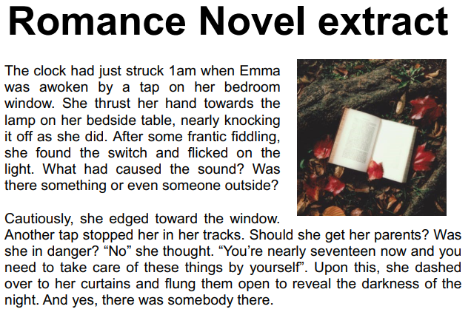
Read the text

Slide 10
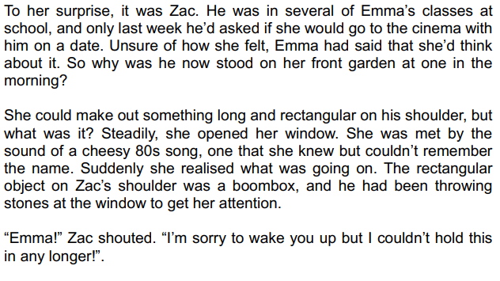

Slide 11
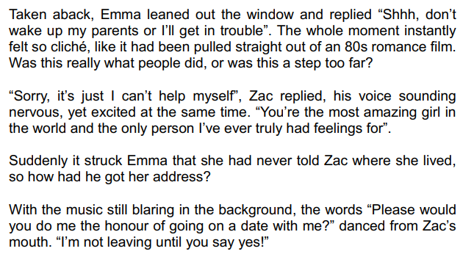

Slide 12
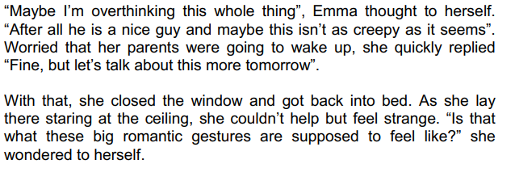

Slide 13
Does this text remind you of any other romantic movies, books or music videos? How?
Is any of this romantic? Why/why not?
What can this excerpt tell us about gender roles and romance?
What can this excerpt tell us about sexuality and romance?
Notes:
Romance Novel
In small groups, students should read the ‘Romance Novel Excerpt’ on the romance novel worksheet.
Then hand out the ‘Romance Novel Excerpt—Questions’ worksheet. This will ask groups to discuss and note their answer to the following:
1. Does this text remind you of any other romantic movies, books or music videos? How?
2. Is any of this romantic? Why/why not?
3. What can this excerpt tell us about gender roles and romance?
4. What can this excerpt tell us about sexuality and romance?
Share the results of the discussion with the class.

Slide 14
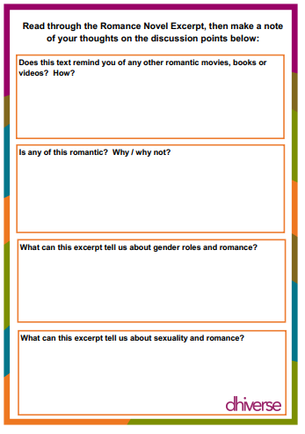

Slide 15
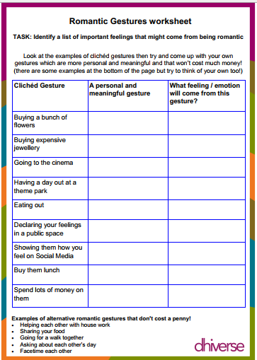
Relationships
Wednesday, 11 May 2022
Task
On you handout, identify the important feelings that might come form being romantic.
EXCELLENCE - INNOVATION - RESPECT

Slide 16
How about a new romantic script?
Notes:
Romantic Gestures Worksheet
Hand out Romantic Gestures worksheet.
Students are prompted to think about how they would like to change the way we see romance. They are asked to consider how they would like romantic gestures to make them feel, and to come up with ideas for romantic gestures that would achieve this.
Remind students that romantic gestures come in all forms but what is most important, is the feelings that these gestures provoke Clichéd gestures can be great but they often include spending money or are things that aren’t possible for teenagers to do!

Slide 17
Relationships
Wednesday, 11 May 2022
Baseline activity Revisited
Using a different colour go back and look at what you wrote about romance. Would you change or add anything?
What is romance to you?
Write a sentence/definition or a spider diagram to explain what romance means to you.
EXCELLENCE - INNOVATION - RESPECT

