Slide 1
Friday, 13 May 2022
Life
Studies

Slide 2
Friday, 13 May 2022
Life
Studies
Relationships
Unpicking gender

Slide 3
Relationships
Ground rules
Friday, 13 May 2022
Ground rules for our room
Many topics we cover in Life Studies can be very sensitive and can have a different level of importance and effect on different people. To get the best out of each lesson your participation is essential. In order to respect each other’s opinions and right to freely contribute we should establish some ground rules.
Task
Take a few minutes with a partner to go over your rules from the last topic and come up with any amendments you think are important to helping you feel confident to contribute in your Life Studies lessons?
Now feed back to the class.
Amend your rules if necessary
EXCELLENCE - INNOVATION - RESPECT

Slide 4
Relationships
Friday, 13 May 2022
Key learning outcomes
What should you expect in this lesson?
Explain what we mean by ‘gender’
Recognise the influences that create gendered behaviour
Identify and challenge gender stereotypes
EXCELLENCE - INNOVATION - RESPECT

Slide 5
Relationships
Friday, 13 May 2022
Baseline activity
The Accident
A boy and his father are in their car, travelling to the swimming pool one Saturday afternoon.
On the way, they have an accident and the father is seriously injured.
An ambulance arrives and takes the boy to hospital for emergency surgery.
On arrival, the surgeon comes to assess the boy’s injuries and on seeing him, shouts, “Oh no! My son, that’s my son!”
How so?
EXCELLENCE - INNOVATION - RESPECT

Slide 6
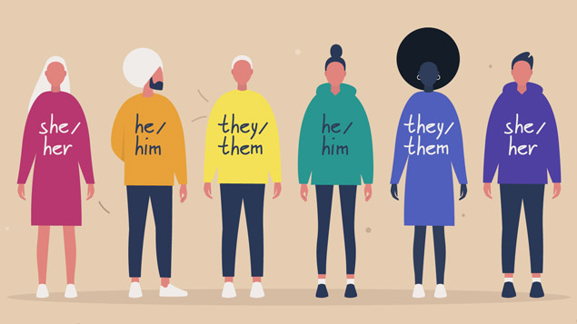
What do we mean by gender?
girl/woman
boy/man
Non-binary /other gender(s)
How you think and feel about yourself; your internal sense of who you are.
feminine
masculine
androgynous/other
How you display your gender; what name and pronouns you use, how you act, dress, behave and interact with the world.

Slide 7
Agree or Disagree?
You can tell someone’s gender identity just by looking at them.
Further questions:
Do we make a decision based on a person’s gender identity or their gender expression?
Do we make assumptions about their gender identity?

Slide 8
Gender roles and behaviours
Task
In groups discuss examples of gender roles and behaviour.
Where do these ideas come from?
Society’s expectations of how people should behave based on their gender.
Gender roles in UK majority culture have relaxed over time, but they still exist..
Can you think of examples?
Gendered expectations can lead to stereotypes. How do these gender stereotypes affect us?
Task - discuss
What happens if you don’t conform to gender stereotypes?

Slide 9
Challenging gender stereotypes
Watch the video clip
https://www.youtube.com/watch?v=HzN2417-d78
Notes:
https://www.youtube.com/watch?v=HzN2417-d78

Slide 10
Challenging gender stereotypes
In pairs discuss: what you do that conforms to a gender stereotype and why you do it?
Notes:
https://www.youtube.com/watch?v=HzN2417-d78

Slide 11
Don’t judge, celebrate!
The video urges you: DON’T JUDGE, CELEBRATE.
How could you share this message with other students ?
Are there any role models that challenge gender stereotypes that could be used to convey this message?

Slide 12
http://thekitetrust.org.uk/
Text/whatsapp: 07808189158
Email: info@thekitetrust.org.uk
Notes:
Pass on details of support available to young people:
http://thekitetrust.org.uk/
Text/whatsapp: 07808189158
Email: info@thekitetrust.org.uk

Slide 14
Relationships
Friday, 13 May 2022
Baseline activity revisited
Revisit your own definition of the word respect. With a different colour pen would you change or add anything?
EXCELLENCE - INNOVATION - RESPECT

Slide 15
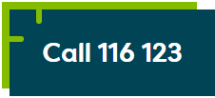
Signposting
Signposting
Friday, 13 May 2022
If you want to talk to someone about today’s lesson or find out more information about this topic the following available:
Your Tutor
Your Head of Year
Any of these links/numbers
https://www.samaritans.org/about-samaritans/
https://www.kooth.com/
Under 18yrs
EXCELLENCE - INNOVATION - RESPECT

Slide 16
Signposting
Signposting Useful contacts – for young people
Friday, 13 May 2022
Beat
0808 801 0711 (youthline) 0808 801 0811 (studentline) beateatingdisorders.co.uk Under 18s helpline, webchat and online support groups for people with eating disorders, such as anorexia and bulimia.
Campaign Against Living Miserably (CALM)
0800 58 58 58 thecalmzone.net Provides listening services, information and support for anyone who needs to talk, including a web chat.
Centrepoint
0808 800 0661
Details of places you can go if you're a young person looking for support or information. Useful contacts
Action for Children
actionforchildren.org.uk Charity supporting children, young people and their families across England.
Anxiety UK
03444 775 774 (helpline) 07537 416 905 (text) anxietyuk.org.uk Advice and support for people living with anxiety.
EXCELLENCE - INNOVATION - RESPECT

