Slide 1
Monday, 10 July 2023
Life
Studies

Slide 2
Consent – Avoiding assumptions
Monday, 10 July 2023
Life
Studies
Relationships

Slide 3
Teachers:
You will need to look at the notes from the PDF doc.
Lesson 4 pages 15 – 19
Resources – pages 36 - 43

Slide 4
Relationships
Ground rules
Monday, 10 July 2023
Ground rules for our room
Many topics we cover in Life Studies can be very sensitive and can have a different level of importance and effect on different people. To get the best out of each lesson your participation is essential. In order to respect each other’s opinions and right to freely contribute we should establish some ground rules.
Task
Take a few minutes with a partner to go over your rules from the last topic and come up with any amendments you think are important to helping you feel confident to contribute in your Life Studies lessons?
Now feed back to the class.
Amend your rules if necessary
EXCELLENCE - INNOVATION - RESPECT

Slide 5
Relationships
Monday, 10 July 2023
Key learning outcomes
Learning outcomes
I can identify common assumptions relating to consent and explain why these are wrong
I can explain the right to not give, or withdraw consent at any time and why this must be respected
I can describe or demonstrate ways to avoid making assumptions related to consent, and strategies someone could use to not give or withdraw consent
EXCELLENCE - INNOVATION - RESPECT

Slide 6
Relationships
Monday, 10 July 2023
Key learning objectives
Learning objective
We are learning about common assumptions related to consent and how to challenge these.
EXCELLENCE - INNOVATION - RESPECT

Slide 7
Relationships
Monday, 10 July 2023
Baseline activity
In pairs, summarise everything you know about the concept of consent.
You could do this in any format, for example:
a short rap
a 60 second news bulletin
an acrostic poem
EXCELLENCE - INNOVATION - RESPECT

Slide 8
Assumption statements
See resources doc in folder
Pick the ones you want to use with your class

Slide 9
Assumption statements
In groups, discuss the statement and make notes on the following questions:
• Do you agree with the statement? Why / why not?
• If the first part of the statement is true, does that mean the second part must be true? Why / why not?
• How do you think each person in the situation is feeling right now?
• What do you think might happen next?
Optional extra activity
When you have noted your responses to the first statement, pass your sheet to the next group.

Slide 10
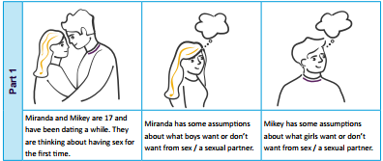
Assumptions and their consequences
Page 24
1. Read part 1. List as many assumptions as you can that Mikey and Miranda might be making.

Slide 11
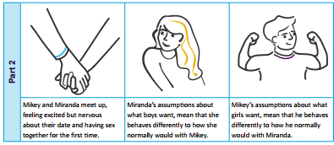
Assumptions and their consequences
2. Read part 2. How might these assumptions make Miranda and Mikey behave differently when they get together?

Slide 12
Assumptions and their consequences
3. Discuss:
Where might Mikey’s and Miranda’s assumptions about sex have come from?
Are the assumptions likely to help Mikey and Miranda have a positive, healthy, sexual experience? Why / why not?
What might help Mikey and Miranda to manage their assumptions and make for a better experience for both of them?
How might these assumptions be similar or different in a same sex relationship?

Slide 13
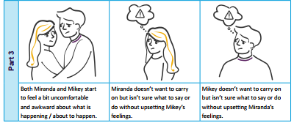
Advising Miranda and Mikey
As a class, read part 3. Can you write some advice to either Miranda or Mikey, explaining all the different ways they could withdraw their consent?

Slide 14
Advising Miranda and Mikey
As a class, read part 3. Can you write some advice to either Miranda or Mikey, explaining all the different ways they could withdraw their consent?
What could they say to withdraw their consent?
What could they do to show they are no longer consenting?
How do you think a loving partner is likely to respond?
What might they do / say if their partner accused them of ‘leading them on’?

Slide 15
Endpoint assessment
We are all going to say aloud a phrase or response that someone could use to not give, or to withdraw, consent.
….
….

Slide 16
More activities
Consent on TV
Note any examples from the television shows you watch, where consent was respected or not respected.
Try to identify any verbal or non-verbal cues given by the characters, and any assumptions either of the characters make.
Can you suggest ways in which these assumptions could have been avoided?

Slide 17
Signposting support
If you would like further guidance or support:
speak to a parent/carer, tutor, head of year, school nurse/counsellor or other trusted member of staff in the school
Visit:
A Better Medway: www.abettermedway.co.uk
Brook: www.brook.org.uk/help-advice
Childline: www.childline.org.uk 0800 1111

Slide 18
Relationships
Monday, 10 July 2023
title
EXCELLENCE - INNOVATION - RESPECT

Slide 20
Relationships
Monday, 10 July 2023
Baseline activity revisited
Go back to the first task and re-read your answer. Using a different colour would you add or change anything?
EXCELLENCE - INNOVATION - RESPECT

Slide 21
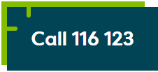
Signposting
Signposting
Monday, 10 July 2023
If you want to talk to someone about today’s lesson or find out more information about this topic the following available:
Your Tutor
Your Head of Year
Any of these links/numbers
https://www.samaritans.org/about-samaritans/
https://www.kooth.com/
Under 18yrs
EXCELLENCE - INNOVATION - RESPECT

Slide 22
Signposting
Signposting Useful contacts – for young people
Monday, 10 July 2023
Beat
0808 801 0711 (youthline) 0808 801 0811 (studentline) beateatingdisorders.co.uk Under 18s helpline, webchat and online support groups for people with eating disorders, such as anorexia and bulimia.
Campaign Against Living Miserably (CALM)
0800 58 58 58 thecalmzone.net Provides listening services, information and support for anyone who needs to talk, including a web chat.
Centrepoint
0808 800 0661
Details of places you can go if you're a young person looking for support or information. Useful contacts
Action for Children
actionforchildren.org.uk Charity supporting children, young people and their families across England.
Anxiety UK
03444 775 774 (helpline) 07537 416 905 (text) anxietyuk.org.uk Advice and support for people living with anxiety.
EXCELLENCE - INNOVATION - RESPECT

