Slide 1
Thursday, 29 June 2023
Life
Studies

Slide 2
Thursday, 29 June 2023
Life
Studies
Relationships
Breaking Up and Making Up

Slide 3
Relationships
Ground rules
Thursday, 29 June 2023
Ground rules for our room
Many topics we cover in Life Studies can be very sensitive and can have a different level of importance and effect on different people. To get the best out of each lesson your participation is essential. In order to respect each other’s opinions and right to freely contribute we should establish some ground rules.
Task
Take a few minutes with a partner to go over your rules from the last topic and come up with any amendments you think are important to helping you feel confident to contribute in your Life Studies lessons?
Now feed back to the class.
Amend your rules if necessary
EXCELLENCE - INNOVATION - RESPECT

Slide 4
Relationships
Thursday, 29 June 2023
Key learning outcomes
EXCELLENCE - INNOVATION - RESPECT

Slide 5
Relationships
Thursday, 29 June 2023
Key learning objectives
The aim of this lesson is to think about when and how it’s appropriate to end a relationship
We will:
Look at attachment styles and the needs that our relationships meet
Recognise healthy and unhealthy patterns of conflict in relationships
Come up with effective and caring methods for ending a relationship
EXCELLENCE - INNOVATION - RESPECT

Slide 6
Relationships
Thursday, 29 June 2023
Baseline activity
EXCELLENCE - INNOVATION - RESPECT

Slide 7
Let’s meet:
Katie & Josh
Ashley and Taylor
Connor and Sarah
Notes:
Case study worksheet 1
Hand out the first relationships case study worksheet. This worksheet introduces the students to three fictional relationships.
In addition to this, it outlines three different relationship attachment styles. Students are asked to decide which relationship style might apply for each couple.
Case study worksheet 2
Hand out the second worksheet. Students will learn a bit more about each person in each relationship. They will be asked to consider what each person might be looking to get out of their relationship; what needs are being expressed.
Case study worksheet 3
The case studies will develop in worksheet number 3, as new information comes to light.
The students will be asked to make judgement about which couples should break up and which couples should stay together. They’ll be asked to explain their reasoning. The pairs don’t necessarily have to agree, disagreements between students should be welcome. Ask students, for the cards they’ve selected as ‘make up’, what conditions would make this possible?

Slide 8
Worksheet One
Which relationships style might
apply for each of the three couples?
Read the scenarios then fill in the sheet

Slide 9
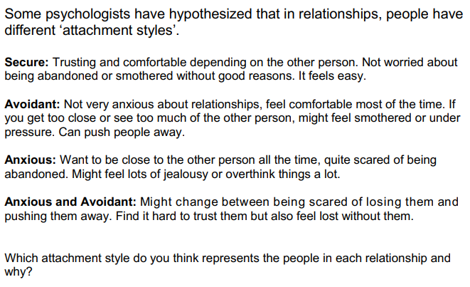

Slide 10
Worksheet Two
What might each person be looking to get out of the relationship?
What needs are being expressed?

Slide 11
Worksheet Three
Which couples do you think should break up, and which should stay together?
What’s your reasoning?
For the couples you judge should “make up”, what conditions would make that possible?

Slide 12
Worksheet Four
In your groups:
Devise a plan for how the couples should break up in a way that is both safe and kind

Slide 13
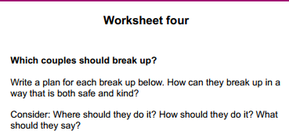

Slide 14
Extension activity: over to you!
In your groups, write a short relationship scenario of your own.
Pass this to the group on your left, who should explore it using the same four steps we’ve used today with the couples.

Slide 18
Relationships
Thursday, 29 June 2023
title
EXCELLENCE - INNOVATION - RESPECT

Slide 20
Relationships
Thursday, 29 June 2023
Baseline activity revisited
Go back to the first task and re-read your answer. Using a different colour would you add or change anything?
EXCELLENCE - INNOVATION - RESPECT

Slide 21
Signposting
Signposting
Thursday, 29 June 2023
If you want to talk to someone about today’s lesson or find out more information about this topic the following available:
Your Tutor
Your Head of Year
Any of these links/numbers
https://www.samaritans.org/about-samaritans/
https://www.kooth.com/
Under 18yrs
EXCELLENCE - INNOVATION - RESPECT

Slide 22
Signposting
Signposting Useful contacts – for young people
Thursday, 29 June 2023
Beat
0808 801 0711 (youthline) 0808 801 0811 (studentline) beateatingdisorders.co.uk Under 18s helpline, webchat and online support groups for people with eating disorders, such as anorexia and bulimia.
Campaign Against Living Miserably (CALM)
0800 58 58 58 thecalmzone.net Provides listening services, information and support for anyone who needs to talk, including a web chat.
Centrepoint
0808 800 0661
Details of places you can go if you're a young person looking for support or information. Useful contacts
Action for Children
actionforchildren.org.uk Charity supporting children, young people and their families across England.
Anxiety UK
03444 775 774 (helpline) 07537 416 905 (text) anxietyuk.org.uk Advice and support for people living with anxiety.
EXCELLENCE - INNOVATION - RESPECT

