Slide 1
Thursday, 12 May 2022
Life
Studies

Slide 2
Thursday, 12 May 2022
Life
Studies
Relationships
Respect

Slide 3
Respect

Slide 4
Relationships
Ground rules
Thursday, 12 May 2022
Ground rules for our room
Many topics we cover in Life Studies can be very sensitive and can have a different level of importance and effect on different people. To get the best out of each lesson your participation is essential. In order to respect each other’s opinions and right to freely contribute we should establish some ground rules.
Task
Take a few minutes with a partner to go over your rules from the last topic and come up with any amendments you think are important to helping you feel confident to contribute in your Life Studies lessons?
Now feed back to the class.
Amend your rules if necessary
EXCELLENCE - INNOVATION - RESPECT

Slide 5
Relationships
Thursday, 12 May 2022
Key learning outcomes
What should you expect in this lesson?
The aim of this lesson is to explore the idea of respect.
We will
Define respect
Talk about earning respect
Play a game about respecting differences
Write a short letter to our future selves
EXCELLENCE - INNOVATION - RESPECT

Slide 6
Relationships
Thursday, 12 May 2022
Baseline activity
What do we mean by ‘respect’?
Write your own definition of the word respect
EXCELLENCE - INNOVATION - RESPECT

Slide 7
What do we mean by ‘respect’?
Respect is a funny word, it seems to mean different things to different people.
Dictionary definition:
a feeling of deep admiration for someone or something elicited by their abilities, qualities, or achievements

Slide 8
What do we mean by respect?
Do you think respect needs to be earned?
Let’s vote!
If you thinks respect is automatic stand to the right of the room, if you think respect must be earned go to the left side of the room.

Slide 9
What do we mean by respect?
Further discussion:
Is there some respect that we, as humans, all get automatically?
What kind of respect do you have to earn?

Slide 10
Differences and strengths
Activity needs prep of materials of what you have available to you
It’s time to play a game!
In groups, you have 3 minutes to build the tallest tower.
But there’s a catch, you can ONLY use the materials on your desk. you’ve been given.
Good luck!

Slide 11
Stronger together
Was that fair?
Why is it important to have different pieces in your set?
How can we apply this to people?

Slide 12
Self Respect
Sometimes the way we use the idea of ‘self respect’ is actually about meeting someone else’s standards or behaving how someone else thinks we should.
But we should all have things we respect about ourselves. Self respect can be very powerful.
Use the template to write your future self a letter about three things you respect about yourself.

Slide 13
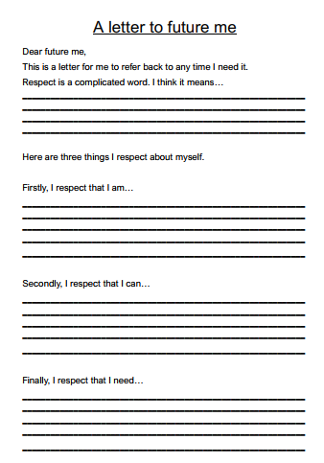

Slide 14
Self Respect
Examples:
I respect that I am bubbly / curious / insightful
I respect that I can be silly / tell good jokes / skateboard
I respect that I need to ask for help / be creative / talk about my

Slide 16
Relationships
Thursday, 12 May 2022
Baseline activity revisited
Revisit your own definition of the word respect. With a different colour pen would you change or add anything?
What do we mean by ‘respect’?
EXCELLENCE - INNOVATION - RESPECT

Slide 17
Signposting
Signposting
Thursday, 12 May 2022
If you want to talk to someone about today’s lesson or find out more information about this topic the following available:
Your Tutor
Your Head of Year
Any of these links/numbers
https://www.samaritans.org/about-samaritans/
https://www.kooth.com/
Under 18yrs
EXCELLENCE - INNOVATION - RESPECT

Slide 18
Signposting
Signposting Useful contacts – for young people
Thursday, 12 May 2022
Beat
0808 801 0711 (youthline) 0808 801 0811 (studentline) beateatingdisorders.co.uk Under 18s helpline, webchat and online support groups for people with eating disorders, such as anorexia and bulimia.
Campaign Against Living Miserably (CALM)
0800 58 58 58 thecalmzone.net Provides listening services, information and support for anyone who needs to talk, including a web chat.
Centrepoint
0808 800 0661
Details of places you can go if you're a young person looking for support or information. Useful contacts
Action for Children
actionforchildren.org.uk Charity supporting children, young people and their families across England.
Anxiety UK
03444 775 774 (helpline) 07537 416 905 (text) anxietyuk.org.uk Advice and support for people living with anxiety.
EXCELLENCE - INNOVATION - RESPECT

